Slide 1
Early Mathematics
Facts Fluency across the P-3 Continuum
Office of K–3
Division of Early Childhood Services

Slide 2

Introduction

Slide 3
Agenda
Three parts to Fluency…and why kids need all three!
Root cause of why children don’t become fluent.
How we can build fluency.
How we can assess fluency.
(Please be advised that neither the New Jersey Department of Education, nor its employees, specifically promotes, endorses, recommends, or favors any of the entities or resources listed herein Instead, this list of entities and resources is provided for informational purposes only. School districts must always evaluate and determine, based on the individualized needs of its student population, whether to utilize and/or expend its resources on the entities or resources herein.)​

Slide 4

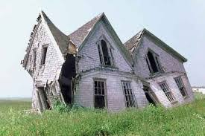
What’s the Goal? (1)

Slide 5
What’s the Goal (2)
258111417202326
2 5 8 11 14 17 20 23 26

Slide 6
NJSLS-Mathematics
Required Fluencies from the NJSLS 2023 and the Preschool Teaching and Learning Standards 2014:
PK.4.2.1: Represent addition and subtraction by manipulating up to 5 objects.
K.OA.5: Add and subtract within 5.
1.OA.C.6: Add and subtract within 10.
2.OA.B.2: Add and subtract within 100.
3.OA.C.7: Multiply and divide within 100; know single digit products from memory
3.NBT.A.2 Add and subtract within 1000.

Slide 7
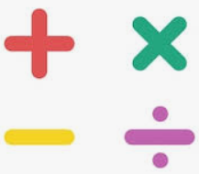
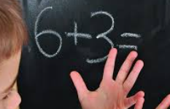

What the research says…
Refers to computation…the four operations. It is about students being able to reason about their own and other’s calculation methods, both written and mental, for the four operations (Bay-Williams & SanGiovanni, 2022).
Refers to adding and subtracting within 20 and multiplying and dividing within 100.
The ability to…
  apply procedures accurately, efficiently, and flexibly,
  transfer procedures to different problems and contexts,
  build or modify procedures from other procedures, and
  reason about the ways in which we use different strategies for different problems (NCTM, 2023).
Computational Fluency
Basic Fact Fluency
Procedural Fluency

Slide 8
Procedural Fluency (1)
National Council of Teachers of Mathematics (NCTM) Position…
“Procedural fluency is an essential component of equitable teaching and is necessary to developing mathematical proficiency and mathematical agency. Each and every student must have access to teaching that connects concepts to procedures, explicitly develops a reasonable repertoire of strategies and algorithms, provides substantial opportunities for students to learn to choose from among the strategies and algorithms in their repertoire, and implements assessment practices that attend to all components of fluency” (NCTM, 2023)

Slide 9
Procedural Fluency (2)
Conceptual Understanding
must precede and coincide with instruction on procedures.
Strategies Procedural fluency requires having a repertoire of strategies.
Basic Facts
Should be taught using number relationships and reasoning, not memorization.
Assessing
Must attend to efficiency and flexibility, not just accuracy and never speed.
NCTM, 2023

Slide 10
Procedural Fluency (3)
Accuracy:
Correctly solving a procedure
Efficiency:
Solving a procedure in a reasonable amount of time by selecting an appropriate strategy and readily implementing that strategy.
Flexibility
Knowing multiple procedures and applying or adapting strategies to solve procedural problems.

Slide 11
Procedural Fluency (3)
Accuracy:
Correctly solving a procedure
Efficiency:
Solving a procedure in a reasonable amount of time by selecting an appropriate strategy and readily implementing that strategy.
Flexibility
Knowing multiple procedures and applying or adapting strategies to solve procedural problems.

Slide 12
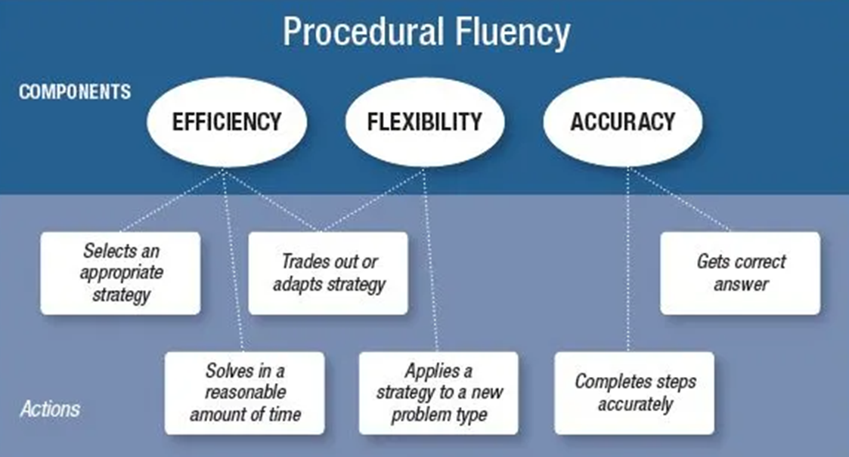
Procedural Fluency (4)

Slide 13
Text Version: Procedural Fluency
Components are efficiency, flexibility, accuracy.
The Actions are:
Selects an appropriate strategy (efficiency)
Trades out or adapts a strategy (efficiency and flexibility)
Gets correct answer (accuracy)
Solves in a reasonable amount of time (efficiency)
Applies a strategy to a new problem type (flexibility)
Completes steps accurately (accuracy)

Slide 14
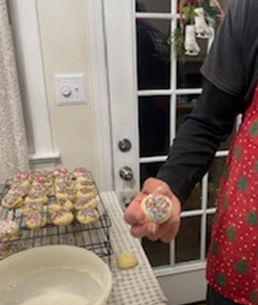

Flexibility (1)
Accuracy, Efficiency, and Flexibility

Slide 15
Flexibility (2)
Facts Mastery
Deriving
Direct Modeling
Counting
Counting all
Counting on/back with fingers
Counting on/back in head/mental strategies
Baroody, 2006; Carpenter et al, 2015

Slide 16



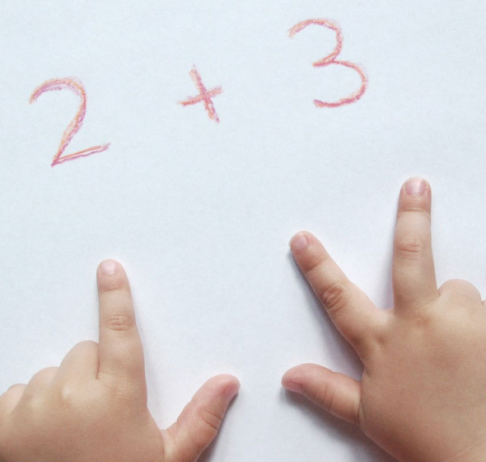

Phase 1: Counting
Direct Modeling
Counting all and counting on
Counting all and counting on with fingers
Counting on in head/mental strategies

Slide 17
Phase 2: Deriving
5 + 6 =
↓
(5 + 5) + 1 = 11
6 + 7 =
↓
?

Slide 18
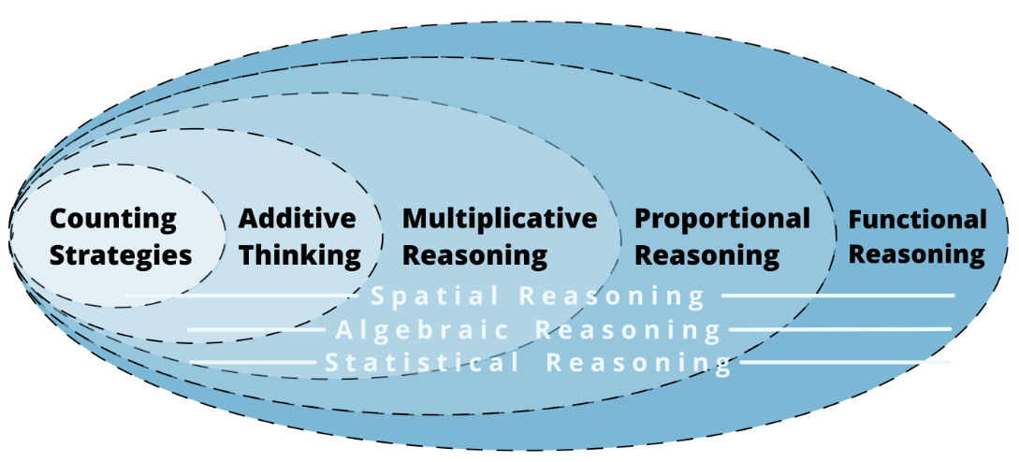
The Development of Mathematical Reasoning
Pam Harris

Slide 19
Text Version: Development of Mathematical Reasoning
Diagram shows a series of nested circles. In order from smallest to largest, the circles are:
1. Counting Strategies
2. Additive Thinking
3. Multiplicative Reasoning
4. Proportional Reasoning
5. Functional Reasoning.
Throughout all of these phases of development you will find spatial reasoning, algebraic reasoning, and statistical reasoning.

Slide 20
Basic Addition Facts (1)
Plus 1
Plus 0
Count On 1 ,2, 3
Add within 5
Make 5
Add within 10
Make 10
Add 10
Doubles
Doubles plus 1
Doubles plus 2
Adding 7, 8, 9
Adding within 20
Make 20
0 + 1 | 7 + 7
2 + 1 | 5 + 6
3 + 2 | 7 + 5
2 + 6 | 9 + 6
4 + 6 | 8 + 4
10 + 4 | 7 + 8
Newton (2016)

Slide 21
Basic Addition Facts (2)
Plus 1
Plus 0
Count On 1 ,2, 3
Add within 5
Make 5
Add within 10
Make 10
Add 10
Doubles
Doubles plus 1
Doubles plus 2
Adding 7, 8, 9
Adding within 20
Make 20
0 + 1 | 7 + 7
2 + 1 | 5 + 6
3 + 2 | 7 + 5
2 + 6 | 9 + 6
4 + 6 | 8 + 4
10 + 4 | 7 + 8
K

Slide 22
Text Version: Basic Addition Facts (2)
Facts Learned in Kindergarten
Plus 1
Plus 0
Count On 1 ,2, 3
Add within 5
Make 5
Examples
0 + 1
2 + 1
3 +2

Slide 23
Basic Addition Facts (3)
Plus 1
Plus 0
Count On 1 ,2, 3
Add within 5
Make 5
Add within 10
Make 10
Add 10
Doubles
Doubles plus 1
Doubles plus 2
Adding 7, 8, 9
Adding within 20
Make 20
0 + 1 | 7 + 7
2 + 1 | 5 + 6
3 + 2 | 7 + 5
2 + 6 | 9 + 6
4 + 6 | 8 + 4
10 + 4 | 7 + 8
K
1

Slide 24
Text Version: Basic Addition Facts (3)
Facts Learned in Grade 1
Add within 10
Make 10
Add 10
Examples
2 + 6
4 + 6
10 + 4

Slide 25
Basic Addition Facts (4)
Plus 1
Plus 0
Count On 1 ,2, 3
Add within 5
Make 5
Add within 10
Make 10
Add 10
Doubles
Doubles plus 1
Doubles plus 2
Adding 7, 8, 9
Adding within 20
Make 20
0 + 1 | 7 + 7
2 + 1 | 5 + 6
3 + 2 | 7 + 5
2 + 6 | 9 + 6
4 + 6 | 8 + 4
10 + 4 | 7 + 8
K
1
2

Slide 26
Text Version: Basic Addition Facts (4)
Facts Learned in Grade 2
Doubles
Doubles plus 1
Doubles plus 2
Adding 7, 8, 9
Adding within 20
Make 20
Examples
7 + 7
5 + 6
7 + 5
9 + 6
8 + 4
7 + 8

Slide 27
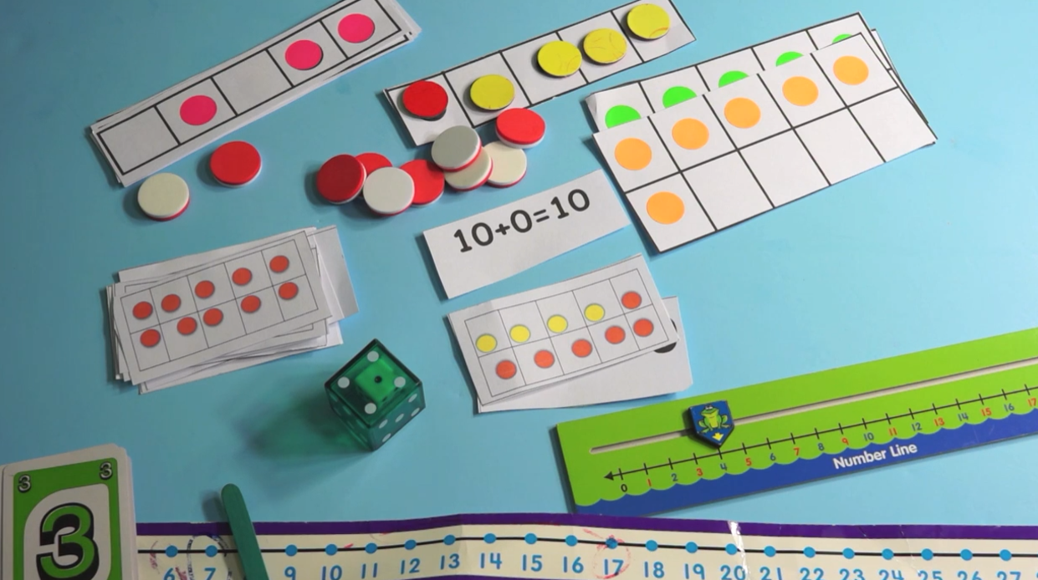
Strategies
Lots of direct modeling!

Slide 28
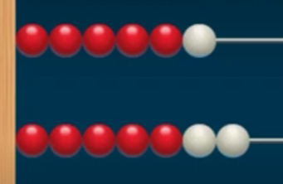
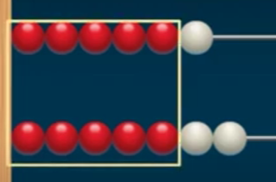
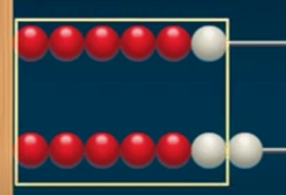
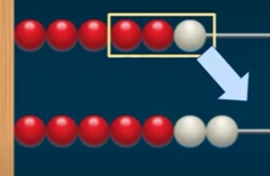
Strategies (2)
6 + 7

Slide 29

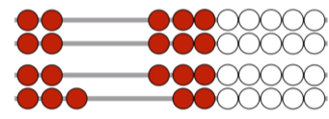

Strategies (3)
Number Strings to develop strategies
3 + 3 = 6
3 + 3 + 1 = 7
or
6 + 1 = 7

Slide 30
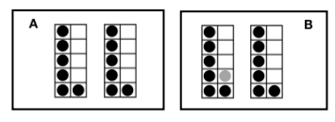
Strategies (4)
Doubles and Near Doubles
Berkeley Everett Math Flips
With each flashcard:
• Look at side A: How many? How do you know?
• (Flip to side B) How many NOW? How do you know?
After a while, ask Generalizing and Extending questions, like:
• How does side A help you with side B?
• What is the same and different about side A and side B?
• What do you notice about this deck?

Slide 31
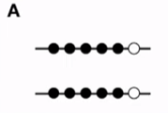
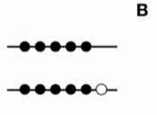
Strategies (5)
Doubles and Near Doubles
Berkeley Everett Math Flips
6 + 6 =
6 + 5 =

Slide 32
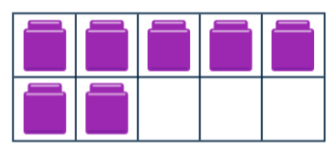
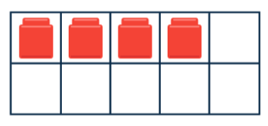
Strategies (6)
Bridge 10 (with 7, 8. 9)
7 + 4 =

Slide 33
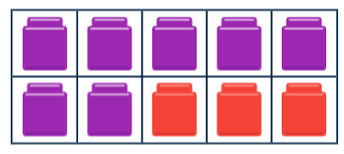
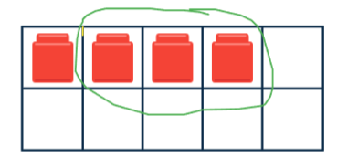
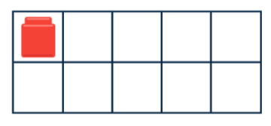
Strategies (7)
Bridge 10 (with 7, 8. 9)
7 + 4 =
10 + 1 =

Slide 34
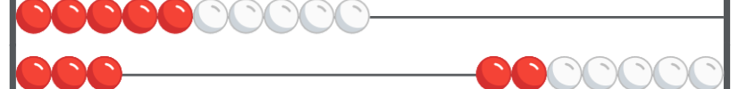
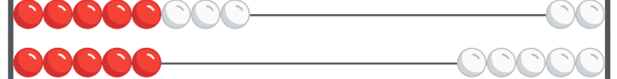
Strategies (8)
8 + 5 =
10 + 3 =

Slide 35
Moving into Additive Thinking
1
49
27
+
6
7

Slide 36
Text Version: Moving into Additive Thinking
Two column addition showing 49 plus 27 equals 76.
There is a blue 1 over the 4 to show carrying the 1 (9 plus 7 equals 16).

Slide 37
Additive Thinking
98 + 54
298 + 156
4/5 + 3/5
.8 + .5

Slide 38
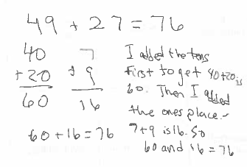
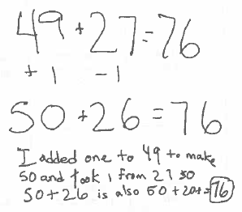
Fluency Actions-Future Impact
Selects an appropriate strategy (not the appropriate strategy!)
412 – 297 = ?
49 + 27 = ?
Count on: skip counting by 10s to 59, then 69, and then counting on by ones to 76.
Compensation: rounding up and subtracting the extra (50 +30 − 4)
Make Tens strategy: renaming as 50 + 26
Partial Sums strategy: adding the tens and the ones then combining as 40 + 20 +16
Think money: 50 + 25 − 1 +2
Standard Algorithm: add the ones, regroup and add the tens.

Slide 39
Text Version: Fluency Actions-Future Impact
Method 1
Method 2
49 plus 27 equals 76
I added the twos first to get 40 plus 20 is 60. Then I added the ones place. 7 plus 9 is 16. So 60 and 16 equals 76.
49 plus 27 equals 76
I added one to 49 to make 50 and took 1 from 27. So 50 plus 26 equals 76.

Slide 40
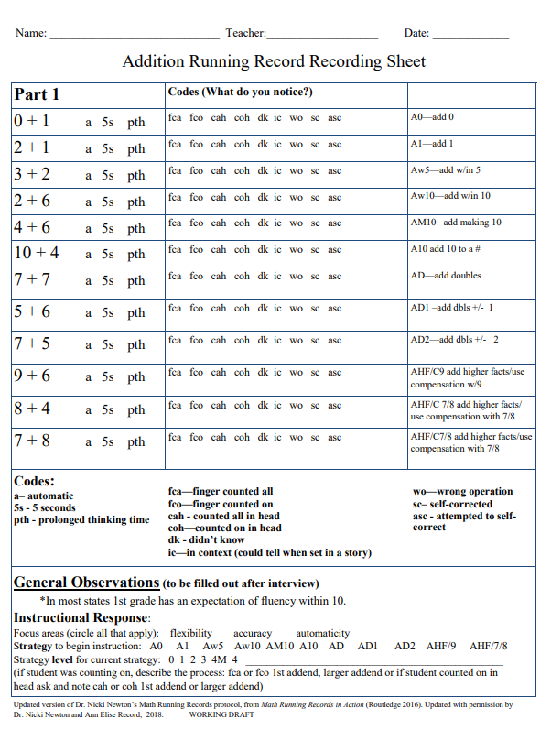
Assessment
Running Records
0 + 1 | 7 + 7
2 + 1 | 5 + 6
3 + 2 | 7 + 5
2 + 6 | 9 + 6
4 + 6 | 8 + 4
10 + 4 | 7 + 8

Slide 41
Partial Text Version: Addition Running Record Sheet
Part 1 | Codes (What do you notice?) | ??
0 + 1 a 5s pth | fca fco cah coh dk ic wo sc asc | A0: add 0
2 + 1 a 5s pth | fca fco cah coh dk ic wo sc asc | A1: add 1
3 + 2 a 5s pth | fca fco cah coh dk ic wo sc asc | Aw5: add within 5
4 + 6 a 5s pth | fca fco cah coh dk ic wo sc asc | Aw10: add within 10
2 + 6 | fca fco cah coh dk ic wo sc asc | AM10: add making 10
10 + 4 a 5s pth | fca fco cah coh dk ic wo sc asc | A10: add 10 to a #
7 + 7 a 5s pth | fca fco cah coh dk ic wo sc asc | AD: add doubles
5 + 6 a 5s pth | fca fco cah coh dk ic wo sc asc | AD1: add doubles ± 1
7 + 5 a 5s pth | fca fco cah coh dk ic wo sc asc | AD2: add doubles ± 2
9 + 6 a 5s pth | fca fco cah coh dk ic wo sc asc | AHF/C9 add higher facts/ use compensation with 9
8 + 4 a 5s pth | fca fco cah coh dk ic wo sc asc | AHF/C7/8 add higher facts/ use compensation with 7/8
7 + 8 a 5s pth | fca fco cah coh dk ic wo sc asc | AHF/C7/8 add higher facts/ use compensation with 7/8
Codes:
a: automatic
5s: 5 seconds
pth: prolonged thinking time
fca: finger counted all
fco: finger counted on
cah: counted all in head
coh: counted on in head
dk: didn’t know
ic: in context (I could tell when set in a story)
wo: wrong operation
sc: self-corrected
asc: attempted to self-correct

Slide 42
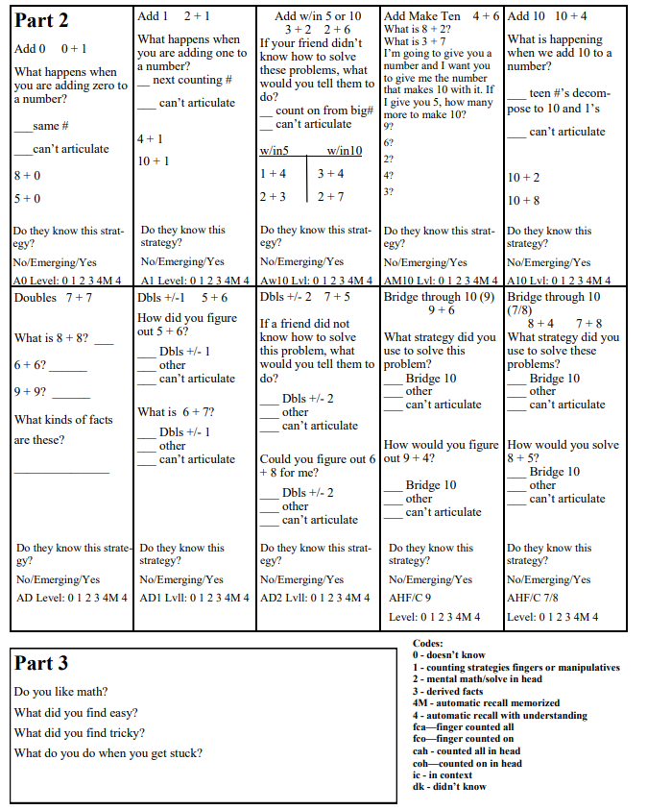
Running Records (1)
Example of an addition running record

Slide 43
Partial Text Version: Running Records (1)
Codes:
0: Doesn’t know
1: counting strategies fingers or manipulatives
2: mental math/solve in head
3: derived facts
4M: automatic recall memorized
4: automatic recall with understanding
fca: finger counted all
fco: finger counted on
cah: counted all in head
coh: counted on in head
dk: didn’t know
ic: in context
Part 2:
Add 0
0 + 1
What happens when you are adding zero to a number?
Same number
Can’t articulate
8 + 0
5 + 0
Do they know this strategy?
No / Emerging / Yes
A0 Level: 0 1 2 3 4M 4
Part 3:
Do you like math?
What did you find easy?
What did you find tricky?
What do you do when you get stuck?

Slide 44
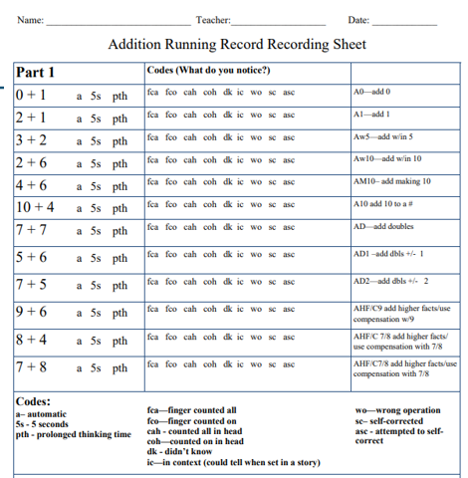
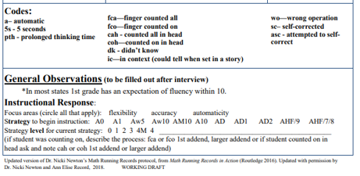
Running Records (2)
Debrief

Slide 45
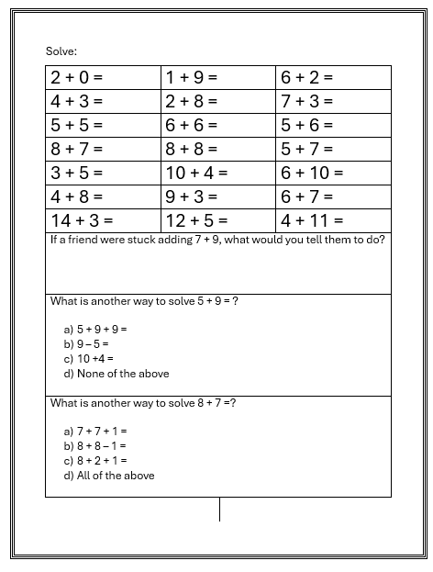
Two Color Probe
Benchmark Problems:
Adding 0 to a number
Adding 1 to a number
Adding within 10
Adding numbers that make 10
Adding doubles facts
Adding doubles plus 1 facts
Adding doubles plus 2 facts
Adding 10 to a number
Adding 7, 8, or 9 to a number
Adding within 20 (larger numbers)

Slide 46
Text Version: Math Test Sheet
Solve:
2 + 0 +
4 + 3 =
5 + 5 =
8 + 7 =
3 + 5 =
4 + 8 =
14 + 3 =
2 + 8 =
6 + 6 =
8 + 8 =
10 + 4 =
9 + 3 =
12 + 5 =
6 + 2 =
7 + 3 =
5 + 6 =
5 + 7 =
6 + 10 =
6 + 7 =
4 + 11=
What is another way to solve 5 + 9 = ?
5 + 9 + 9 =
9 − 5 =
10 + 4 =
None of the above
What is another way to solve 8 + 7 = ?
7 + 7 + 1 =
8 + 8 − 1 =
8 + 2 + 1 =
All of the above
If a friend were stuck adding 7 + 9, what would you tell them to do?

Slide 47
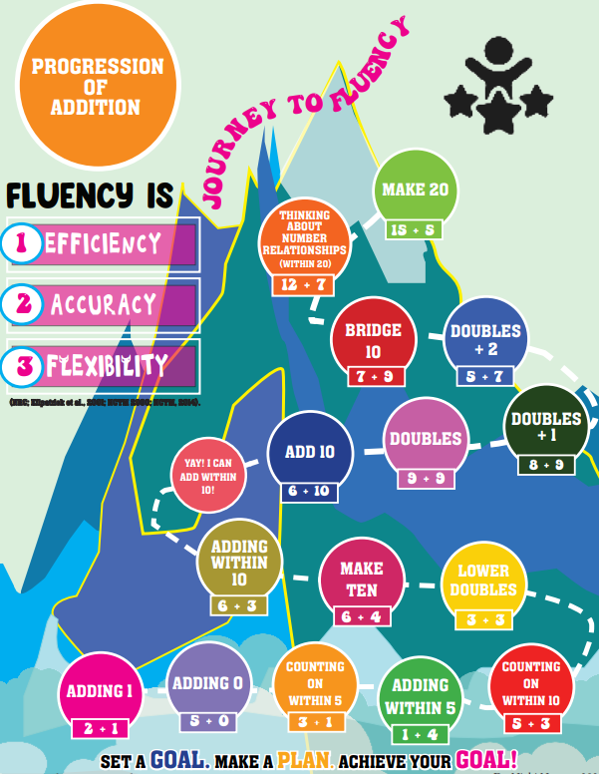
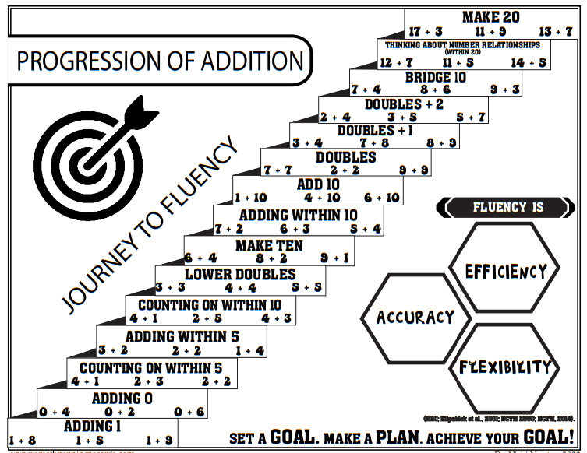
Assessment (2)
Data Binder

Slide 48
Text Version: Progression of Addition Step Diagram
Journey to Fluency
Fluency is
The steps from bottom to top are:
Adding 1
Adding 0
Counting on within 5
Adding within 5
Counting on within 10
Lower doubles
Make Ten
Adding within 10
Add 10
Doubles
Double + 1
Doubles + 2
Bridge 10
Thinking about number relationships (within 20)
Make 20
Accuracy
Efficiency
Flexibility
Set a goal, make a plan, achieve your goal!

Slide 49
Text Version: Progression of Addition Step Diagram
Journey to Fluency
Fluency is
The steps from bottom to top are:
Adding 1
Adding 0
Counting on within 5
Adding within 5
Counting on within 10
Lower doubles
Make Ten
Adding within 10
Add 10
Doubles
Double + 1
Doubles + 2
Bridge 10
Thinking about number relationships (within 20)
Make 20
Accuracy
Efficiency
Flexibility
Set a goal, make a plan, achieve your goal!

Slide 50
Conclusion
The way in which fluency is taught either supports equitable learning or prevents it. Effective teaching of procedural fluency positions students as capable, with reasoning and decision-making at the core of instruction. When such teaching is in place, students stop asking themselves, “How did my teacher show me how to do this?” and instead ask, “Which of the strategies that I know are a good fit for this problem?” The latter question is evidence of the student’s procedural fluency and mathematical agency, critical outcomes in K–12 mathematics. (NCTM, 2023)

Slide 51
References
Baroody, A. J. (2006). Why children have difficulties mastering the basic number combinations and how to help them. Teaching children mathematics, 13(1), 22 – 31.
Baroody, Arthur J., David J. Purpura, Michael D. Eiland, Erin E. Reid, and Veena Paliwal. 2016. “Does Fostering Reasoning Strategies for Relatively Difficult Basic Combinations Promote Transfer by K–3 Students?” Journal of Educational Psychology 108, no. 4
(May): 576–91.Bay-Williams, J. M., & Kling, G., (2019). Math fact fluency: 60+ Games and assessment tools to support learning and retention. ASCD.
Bay-Williams, J. M., & SanGiovanni, J. J. (2021). Figuring out fluency in mathematics teaching and learning, grades K–8: Moving beyond basic facts and memorization. Corwin.
Boaler, J. (2014). Research suggests that timed tests cause math anxiety. Teaching Children Mathematics 20, no. 8 (April): 469–74.
Harris, P., (202, June 6), The Development of Mathematical Reasoning, Math is Figureoutable, https://www.mathisfigureoutable.com/blog/development
Kling, G., & Bay-Williams, J.M. (2021). Eight unproductive practices in developing fact fluency. Mathematics Teacher: Learning and Teaching PK–12. 114(11), 830–38.
NCTM (2023). Procedural fluency reasoning and decision-making, Not Rote Application of Procedures Position.
Newton, N. (2016). Math running records in action: A framework for assessing basic fact fluency in grades K–5. Routledge.

Slide 52
Follow Us on Social Media
Facebook:
@njdeptofed
Instagram:
@newjerseydoe
LinkedIn:
New Jersey Department of Education
Threads:
@NewJerseyDOE
X: @NewJerseyDOE
YouTube: @newjerseydepartmentofeduca6565

Slide 53
Thank You!
New Jersey Department of Education: nj.gov/education
K-3Office@doe.nj.gov

